Slide 1
BUILDING A LEAST-COST, LOW-CARBON, ELECTRICITY SYSTEM WITH
WIND, SOLAR, EFFICIENCY, & INTELLIGENT GRID MANAGEMET:
Electricity is the Core Infrastructure of the 21st Century, Digital economy
Presentation of
Mark Cooper
Director of Research, Consumer Federation of America
to
California Energy Commission, IEPR Commissioner Workshop on
Consumers, Financing, and Workforce
Session 1 of 3:
Consumers and Decarbonization
Monday, July 12

Slide 2
BROAD COST TRENDS OF THE TECHNOLOGICAL REVOLUTION IN ELECTRICITY

Slide 4
Preferred Decarbonization Technologies
Short-term Long-term

Slide 6
WHY FOCUS ON BUILDINGS?
Buildings represent about two fifth (40%) of primary energy consumption in the U.S.
Best practices could cut that in half early in the transition to a low carbon future.
More aggressive mid-term technologies could cut consumption by another 10%.
Building efficiency relieves the pressure on supply-side sources and buildings are particularly important for the dynamic matching of supply and demand.
Efficiency is one of the most attractive resources from the cost, jobs and decarbonization points of view.
Rooftop solar can play an important part in achieving the long term goal (the last 5% or10%), once the institutional (rate structures) are put in place to
recognize the impact and value of “behind the meter” options.

Slide 7
MCKINSEY MARKET IMPERFECTIONS
Consumers
1ST Cost Focus
Low Priority, preference for other attributes
Shop for price and features
Limited understanding of use and savings
Little attention at time of sale
Emergency replacement
Underestimation of load
Aversion to change
Alternatives perceived as inferior
Unrealistic payback hurdles
Limit payback to occupancy period
Improper use and maintenance
Producers
1ST Cost Focus
Competing Use of Capital
Not accountable for use and efficiency
Tenant pays, builder ignores
Efficiency bundled with other attributes
Business failure risk
Lack of reliability
Lack of premium at time of sale
Lack of information
Disruption during improvement process
Difficult to identify efficient devises
Costly time: research procurement & preparation
Lack of qualified contractors
Lack of available technology in area
Lack of demand
Lack of R&D
A standard view of Imperfections Potentially Addressed by Standards
Societal Failures Structural Problems Endemic Flaws Transaction Costs Behavioral
Externalities Scale Agency Sunk Costs, Risk Motivation
Information Bundling Asymmetric Information Risk & Uncertainty Perception
Cost Structure Moral Hazard Imperfect Information Calculation
Product Cycle Product differentiation Execution
Availability Incrementalism

Slide 8
COMMAND-BUT-NOT-CONTROL POLICY:
Long-Term: Setting a progressively rising standard that targets a high long-term goal over the course of a decade or more will foster and support a long-term perspective by reducing the marketplace risk of investing in new technologies. The long-term view gives industry time to re-orient its thinking, retool its plants and help re-educate industry and consumers.
Technology Neutral: Taking a technology neutral approach to a long-term standard unleashes competition around the standard that ensures that the industry will get a wide range of choices at that lowest cost possible.
Product Neutral: The approach to standards must accommodate buyer preferences; it does not try to supplant them. This levels the playing field between producers and removes any pressure to push inappropriate products into the market.
Responsive to industry needs: Establishing a long-term performance standard recognizes the need to keep the standards in touch with reality. The standards can be set at a moderately aggressive level that is clearly beneficial and achievable. With thoughtful cost estimates, consistent with the results of independent analyses of technology costs, a long-term performance standard will contribute to the significant reduction of the cost of compliance.
Responsive to consumer needs: The approach to standards should be consumer-friendly and facilitate compliance. The attribute-based approach ensures that the standards do not require radical changes in the available products or the product features that will be available to consumers. The setting of a coordinated national standard that lays out a steady rate of increase over a long-time period giving the market and the industry certainty and time to adapt to change.
Procompetitive: All of the above characteristics make the standards pro-competitive. Producers have strong incentives to compete around the standard to achieve them in the least cost manner, while targeting the market segments they prefer to serve.
Congress sets broad goals, agencies adopt specific performance targets, and the industry has the flexibility to meet the target in the least cost manner possible. The result is to give consumers the maximum range of choices that comply with the standards and capitalists are driven by consumer sovereignty to do what they do best, minimize cost. To the extent that there is some “restriction of choice”, i.e. the elimination of products that fail to meet the goals, that is governed by the broader principles that the overall rule must be is beneficial, least cost, foster innovation and address specific market failures.

Slide 9
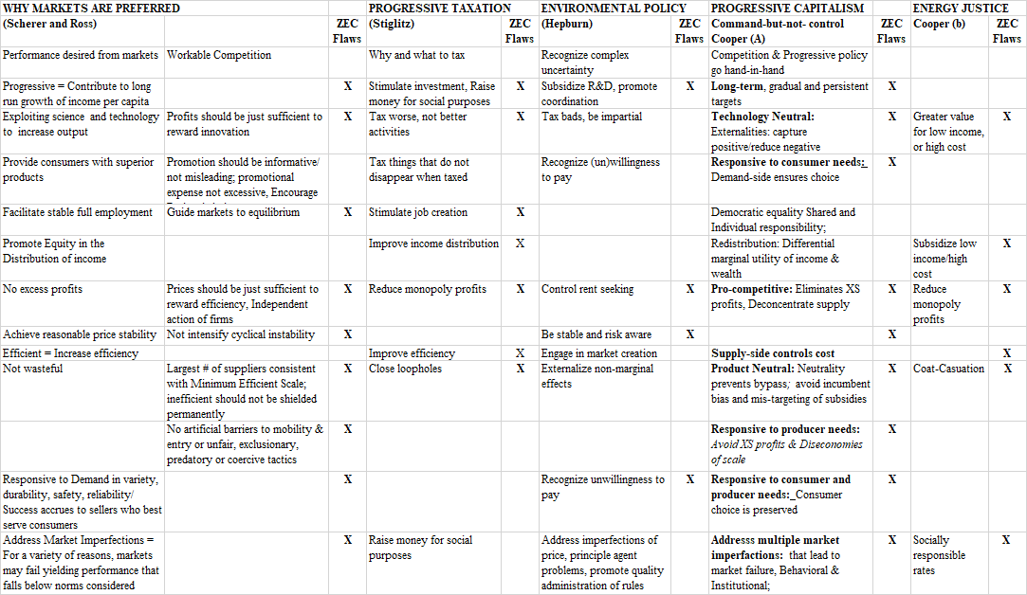
PRINCIPLES AND PRACTICES FOR POLICY IN PRAGMATIC, PROGRESSIVE CAPITALISM

Slide 10
CITATIONS:
2021: https://consumerfed.org/wp-content/uploads/2021/04/Building-a-21st-Century-Electricity-Sector-Report.pdf
2017: https://consumerfed.org/wp-content/uploads/2017/12/two-trillion-dollar-mistake.pdf
2013: https://consumerfed.org/pdfs/Energy_Efficiency_Performance_Standards_Report.pdf

